Slide 1
CSE 6040/x Bootcamp
MT1 Prep Discussion

Slide 2
Discussion Topics
Key concepts for every exam
Topics for MT1
Study timing and planning
Considerations for when to take the exam
Student and TA thoughts on the exam

Slide 3
Key Concepts for Every Exam
The test will ask you to do something that requires you to understand what the inputs and outputs are, and which functions will take you from input to output.
Programming logic. What are the steps required, and in what order?
Given a new module you have never seen before, read the docs and write basic functions

Slide 4
Key Concepts for Every Exam -- 2
Given a new concept, read about it, how it works and what is required, and write the code to output a result set.
Troubleshoot both code and data, when the code does not work and/or the data output is incorrect.
Read and understand the Exam Prep Guide on the course web site.

Slide 5
Topics for MT1 -- 1
Python data structures
Lists, dicts, and sets
Json file to dict
Nested data structures and combinations of them
What they do, when they apply, how to manipulate them
Dictionary items(), keys()
Enumerate, zip
Sorting, and output first/last “n” elements
Summary functions – min, max, median, etc
copy() and deepcopy() for nested data structures

Slide 6
Topics for MT1 -- 2
String manipulation and regex
When to use regex or not
Split(), replace() functions
Translate equations to code
Given a statistical equation, translate to Python
Use built in functions or hand code
Output results to data structures (list, dict, set, etc)

Slide 7
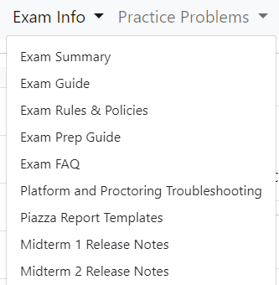
Study Timing and Planning -- 1
What is your study plan? What are the tasks?
What day will you take the test? (See next slide)
Put together your plan
Tasks recommended by the Teaching Staff
Review ALL the exam-related pages.
“Review" means know what is on there and keep that accessible so you can jump to it if needed. For the staff, there is no excuse for skipping this step.
Review the Exam Prep Guide -- Exam Prep Guide
This is a GREAT template for organizing your studying.
Review the Exam Summary (have this open during the exam) -- Exam Summary
Review the Troubleshooting Guide -- Troubleshooting Guide
Develop your cheat sheets/references/bookmarks

Slide 8
Study Timing and Planning -- 2
What is your study plan? What are the tasks to do?
Tasks recommended by the Teaching Staff -- continued
Do the PMT1 notebooks – See listing -- Practice Problems
Do AT LEAST ONE PMT1 Notebook UNDER EXAM CONDITIONS.
Preferably TWO EXAMS.
4-hour time limit (for Tier 1 PMT1 NBs)
One monitor
Cheat sheets/references/bookmarks in use
Perform an after-exam critique of yourself.
What did you do well?
What did not go well, and how can I improve on that?
Put your plan on the calendar, and execute the plan

Slide 9
Thoughts on When to Take the Exam
TA Coverage is generally 8:00 AM to 11:00 PM EDT
If you take outside of this window, support will not be immediate.
Also note that many of the answers the TA’s provide are direct copy/paste from the Troubleshooting Guide.
So, in many cases, if you have followed the guide, you won’t need TA help, because you will have already done what we recommend.
Friday/Weekend
Opens at 8:00 AM EDT Friday.
Typically, fewer students take exam these days.
Less study time by taking the exam earlier in the window.
Monday/Tuesday/Wednesday
Closes at 8:00 AM EDT Wednesday.
Longer time to study.
More students take on these days.
52% of class took MT1 in the last 24 hours.
Vocareum issues and slowness – See next slide
Understand your cost/benefit analysis if you choose to take at the end of the window.

Slide 10
Vocareum on Monday/Tuesday
If you take the exam during peak time, you will probably need to refresh the page a couple of times during the exam per the troubleshooting guide.
Vocareum load balances based on # of student sessions and average resource metric.
We generally write tests that stay within that metric, but we are not able to account for all the permutations of student code to solve the exercises.
So, the resource metric calculation goes awry under the burden of inefficient code, infinite loops, and lots of print output. So that server struggles and slows down.
If you notice the kernel disconnecting or extreme slowness, REFRESH THE PAGE and Vocareum will move/assign your session to a server that is not as crowded (load-balance).

Slide 11
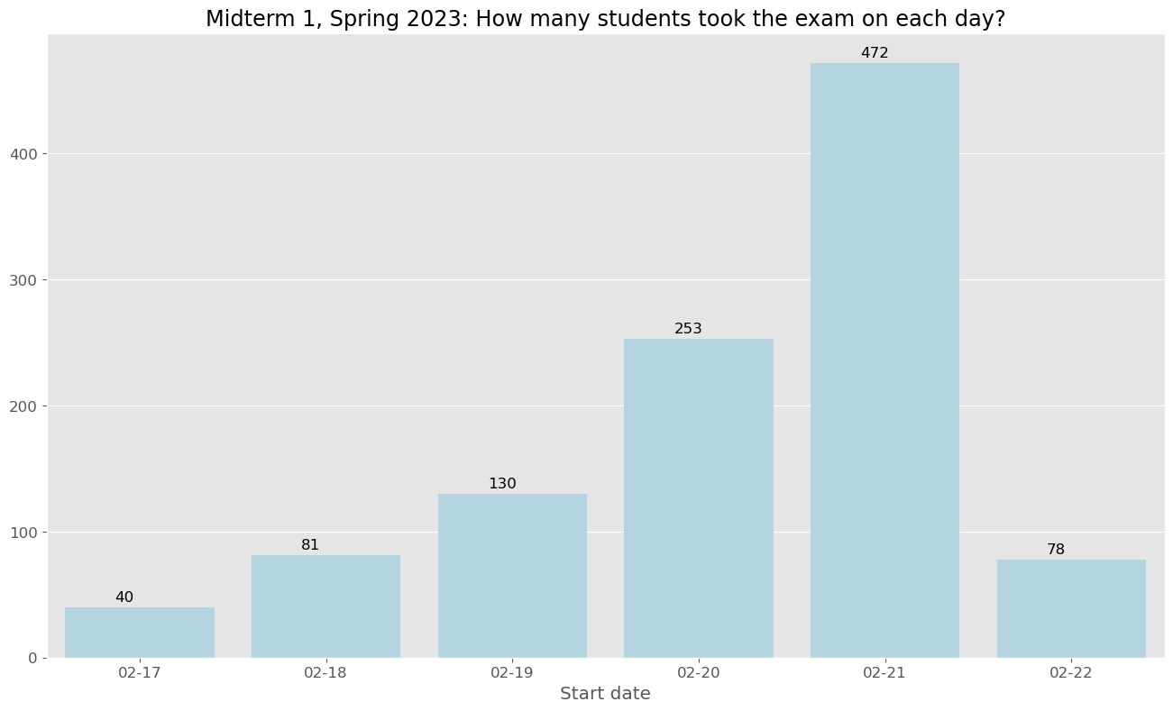

Slide 12
Student Comments on Exams (all comments taken from a Slack thread during the Spring 2023 semester)
Doing the practice problems from recent midterms were some of the best exam prep I've ever done. The midterms were basically testing the exact same skill set with some tweaks in wording and data structures.
The practice problems, being prior exams, were the best prep material anyone could ask for.
I think midterm 1, as mentioned by Prof. Vuduc in the midterm 1 analysis video and elsewhere, is supposed to be difficult, a somewhat steep learning curve if you will, so that you can “get used” to coding under time-bound and other similar circumstances.
I agree coding under time-constraints can be a challenge if you’ve no prior Python experience, but I appreciated how it got easier as the course progressed, even with more complex topics coming in.
CSE-6040 exposes you not to just programming and Python, but also to a lot that goes in coding in the actual world—Googling, stack overflow, getting stuck, and then unstuck—and I am grateful for that.

Slide 13
Some TA thoughts, from taking the class -- 1
One topic that helped me while taking exams: Divide and Conquer.
The whole exam tells a story. This may cause the student to get overwhelmed.
In this situation the best solution is to forget the story and focus on individual exercises and function.
Remember that each exercise is individual, and not dependent on any other exercise.
Read the function specification and simply solve that as if no other exercises exist. That way, you will not be overloaded with too many things.
At the end of the exam, the students can read the story. I am positive this way they will have ample time to complete the exam.
If there is a HINT or RECOMMENDED METHOD/FUNCTION in the exercise description, I WANT TO INCORPORATE IT, almost always.
I practiced troubleshooting the exam variables as part of my preparation; It helped me to already have done that when my solutions did not pass.

Slide 14
Some TA thoughts, from taking the class -- 2
Skim the prompt to get a rough idea of what needs to be done.
Understand what the desired output is and make a very rough plan – Use the method taught in the Bootcamp sessions.
Accept that this plan is probably going to change.
Get something to run - i.e., printing the outputs (or a reasonable sample of them).
Improve on your running solution by implementing the steps to your plan with real code.
The goal here is to make iteratively better running solutions until you get to the real solution.
If you're not sure why something isn't passing, then re-read the prompt and get a better understanding of the requirements.
It is a lot easier to re-read the prompt with "fresh" eyes if it's the first time you're looking at it closely

Slide 15
Open Discussion / Q&A

